Slide 1




SHADOW PUZZLE

Slide 2
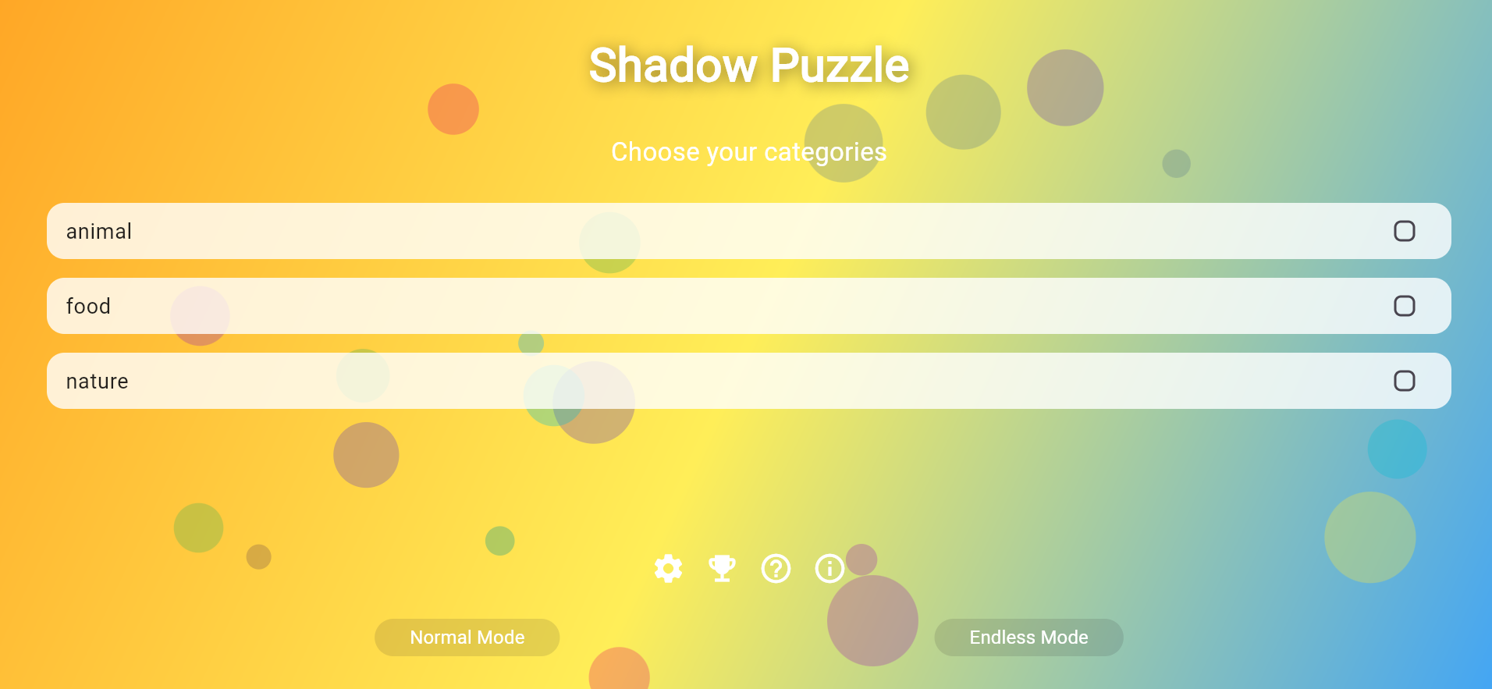
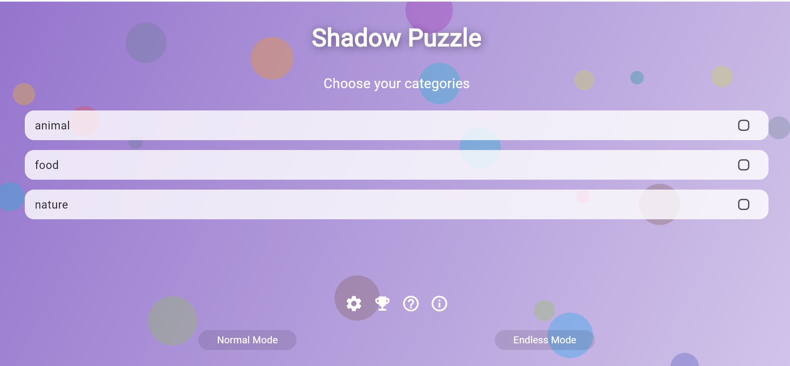
Main Page
The main page has three categories; Animals, Food, Nature.
Which game mode (Normal, Endless) is presented on this page.
There are also Settings, How to Play and Credits and achievement buttons.

Slide 3

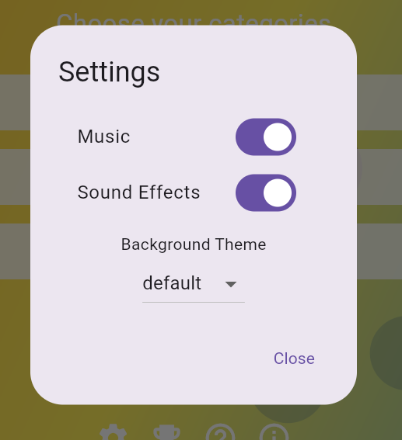
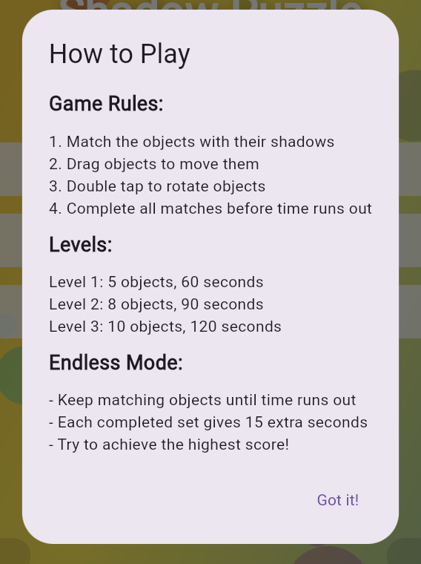
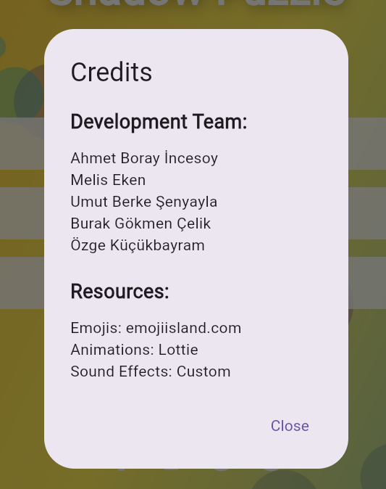
How to play and Settings
There is information about the flow of the game on the main page for users.
The settings button is for sound effects, music and theme selection.

Slide 4
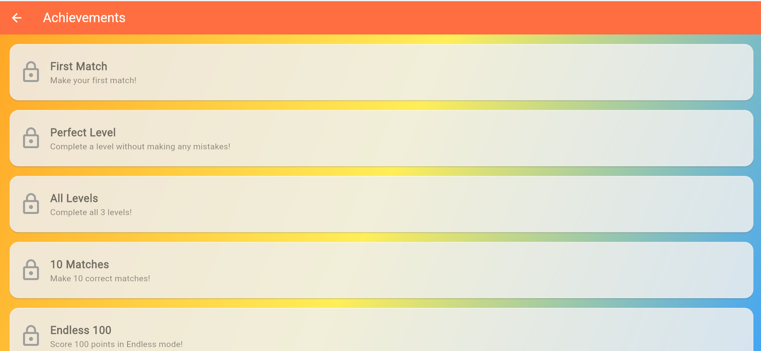
Achievements
Various achievements have been identified to increase the motivation of players.
Locked achievements offer the player goals, increase game time and commitment.

Slide 5
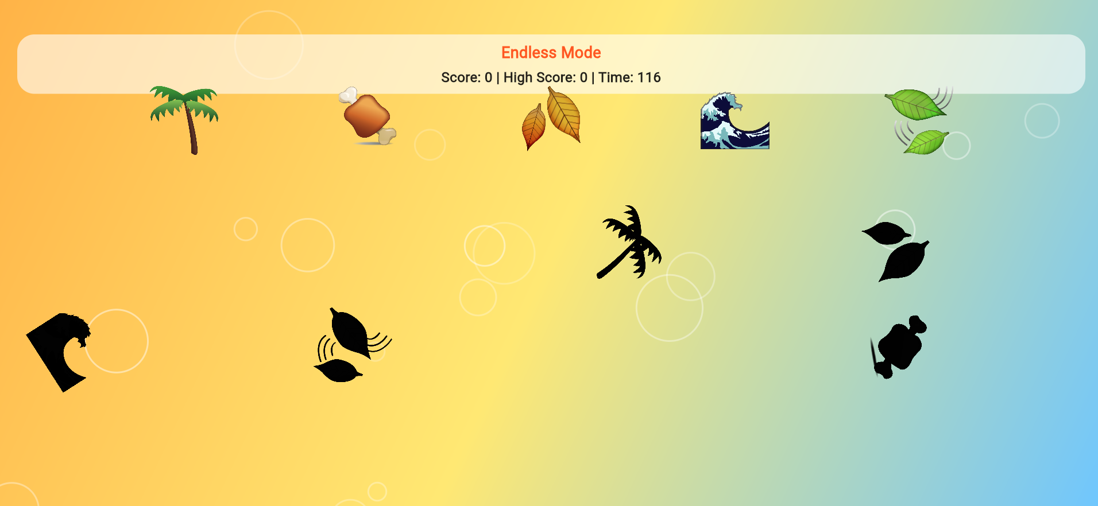
Endless Mode
There is no time limit or level restriction.The goal: To get the highest score by making as many correct matches as possible.
It tests the player's reflex and speed.Provides practice to the game

Slide 6
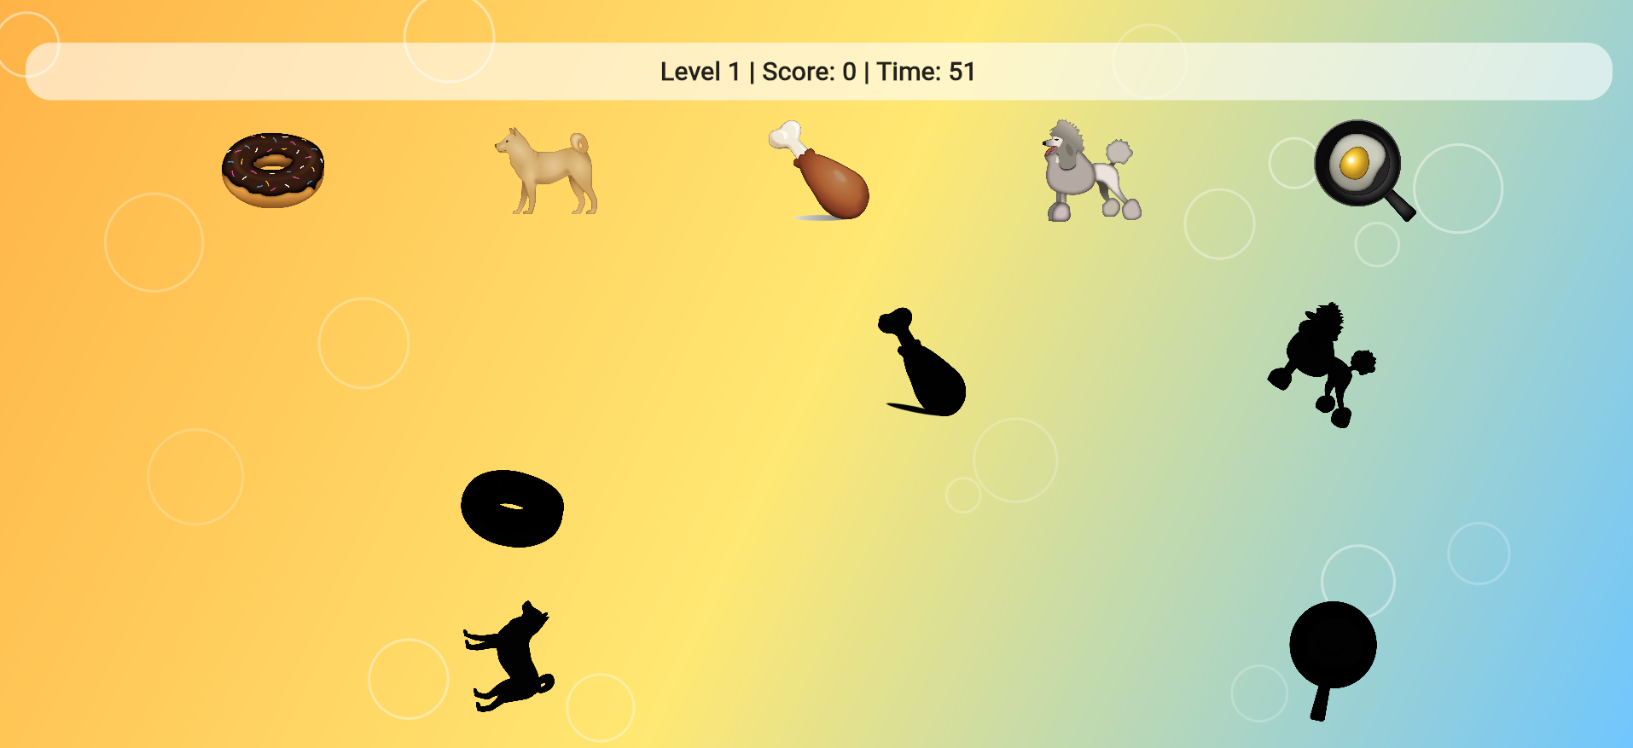
Normal Mode:Level1
There is a time limit in normal mode.The user tries to complete the matches in the selected category with a limited time.

Slide 7
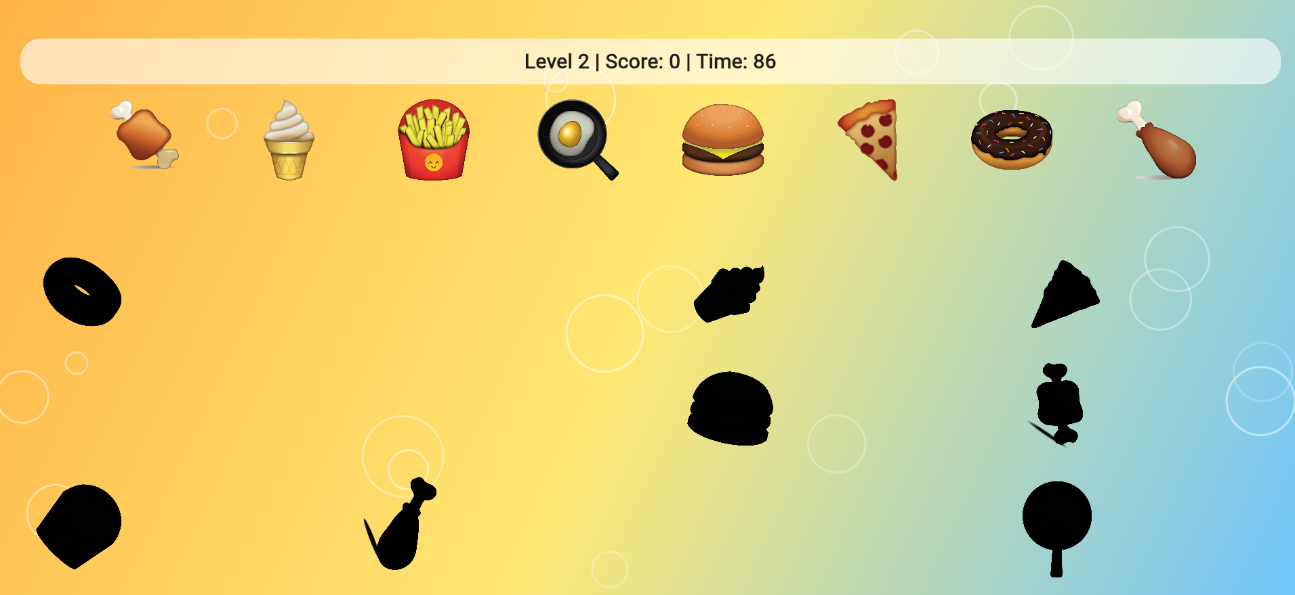
Normal Mode:Level2
The number of matches and the duration change as the level jumps.
Motivation and goal orientation are supported with the success system.

Slide 8
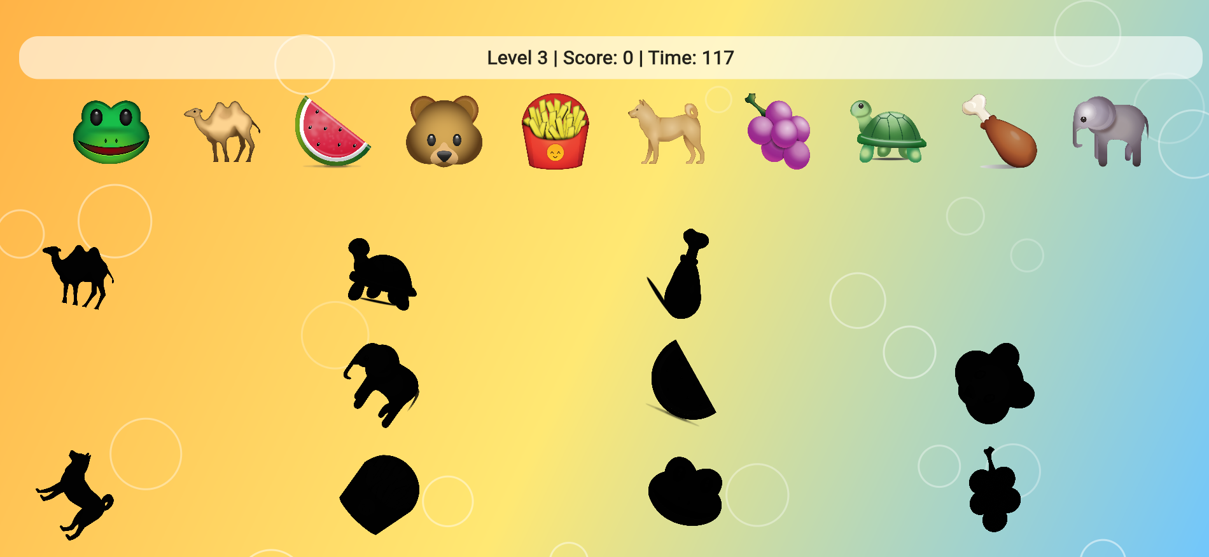
Normal Mode:Level3
This game supports the mental development of children. It gives you the ability to make quick decisions and solve problems.

Slide 9


Thanks to Listening Us
Ahmet Boray Incesoy 2000004295
Melis Eken 1900003330
Umut Berke Senyayla 2000002240
Burak Gokmen Celik 2100002953
Ozge Kucukbayram 2000004664

